Slide 1
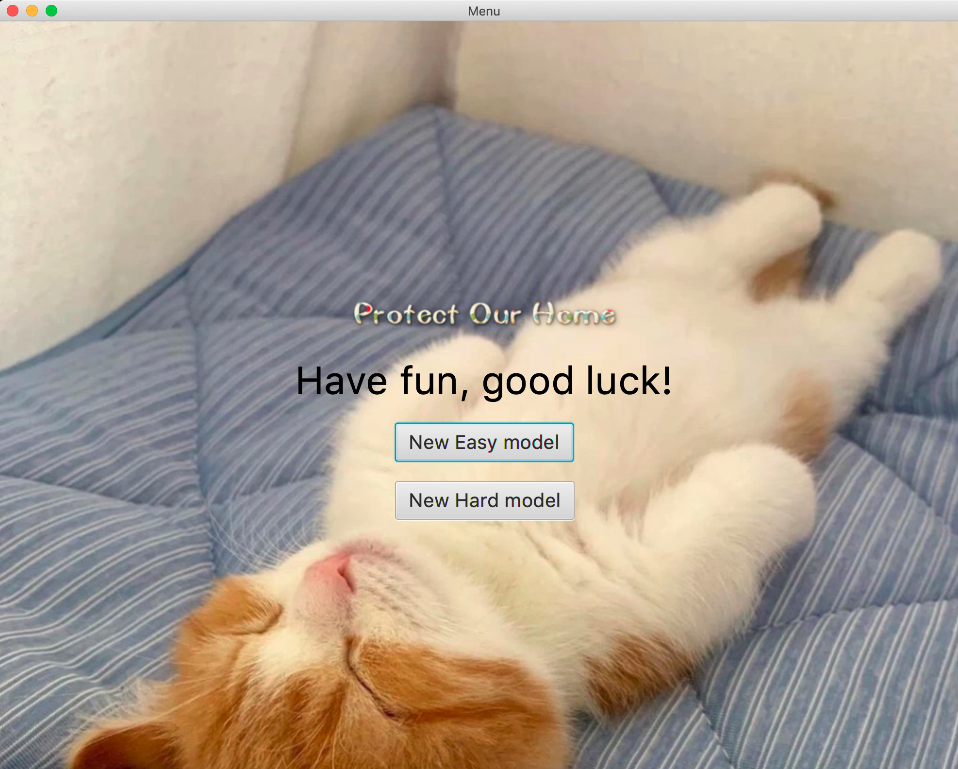

Slide 2
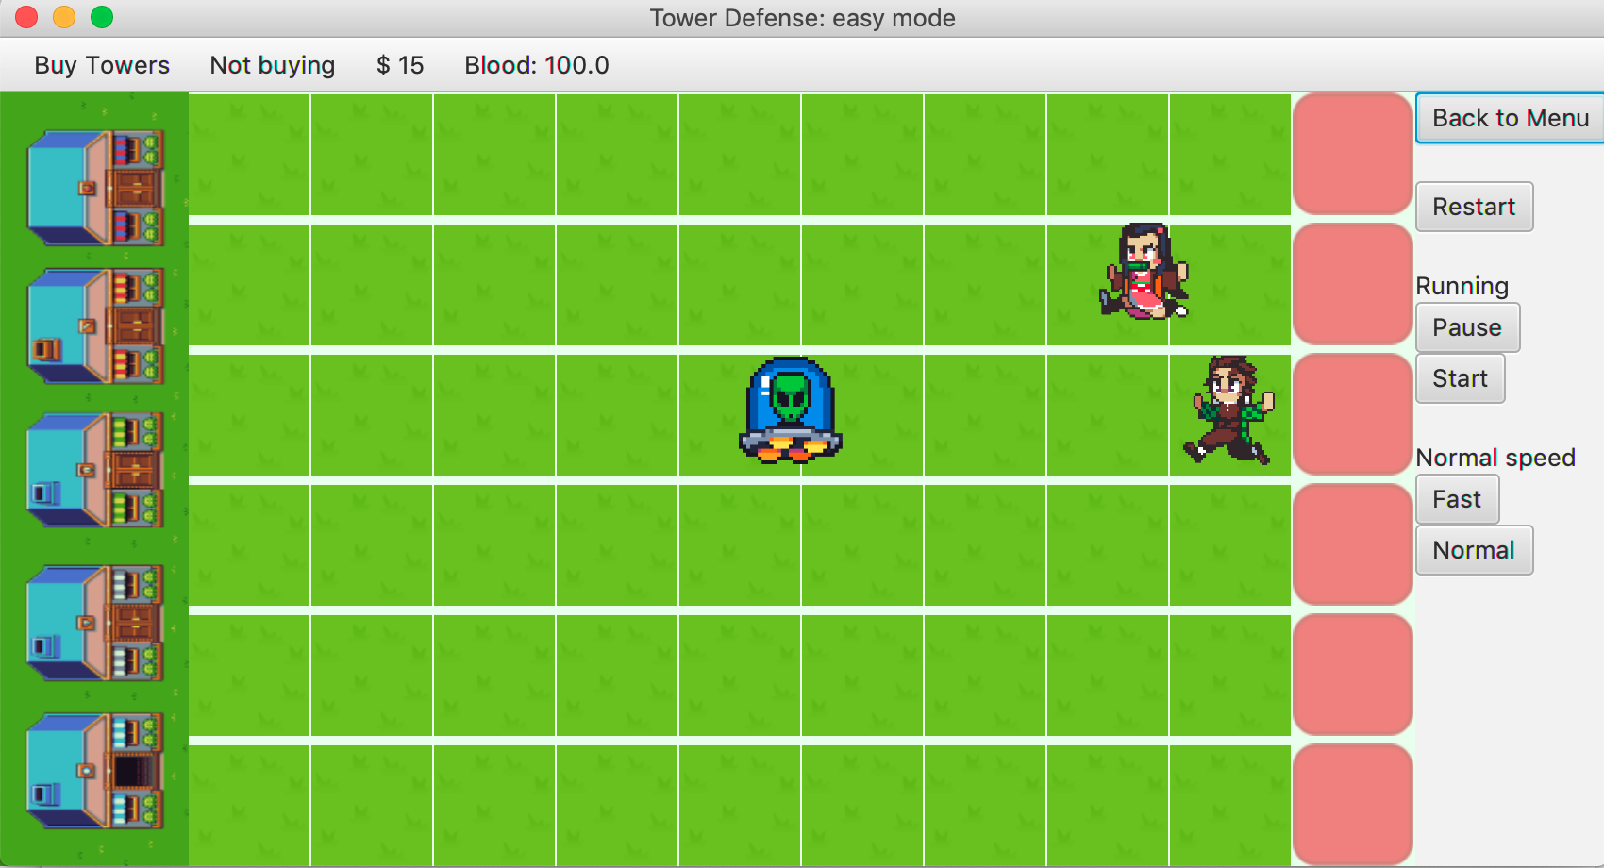

Slide 3
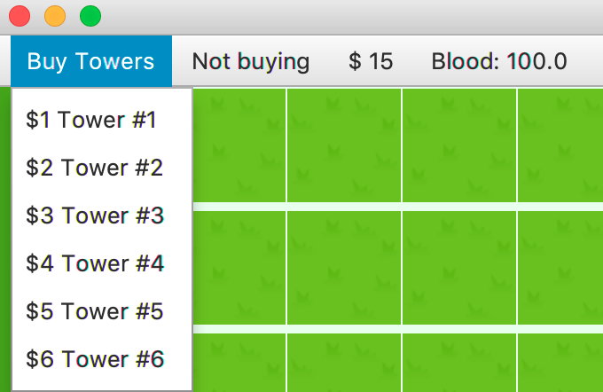
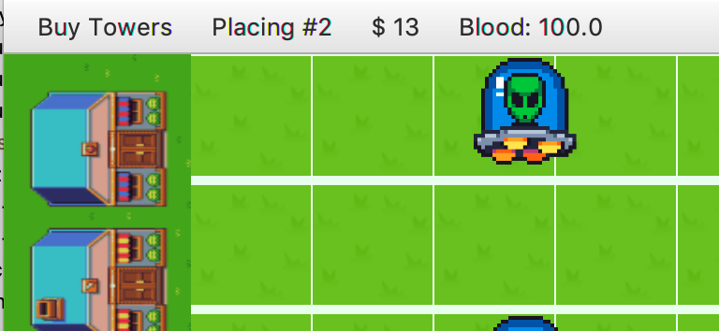
Right click before placing #2 to cancel buying the tower and the currency will add back to 15$.
Can’t buy any tower worth more than your currency.

Slide 4
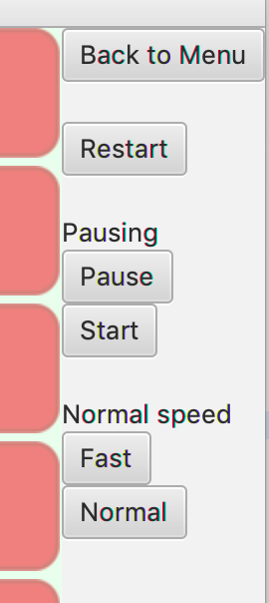
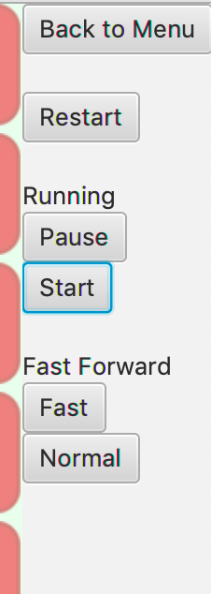
Can’t add any tower while in Pausing or Fast Forwarding mode.

Slide 5
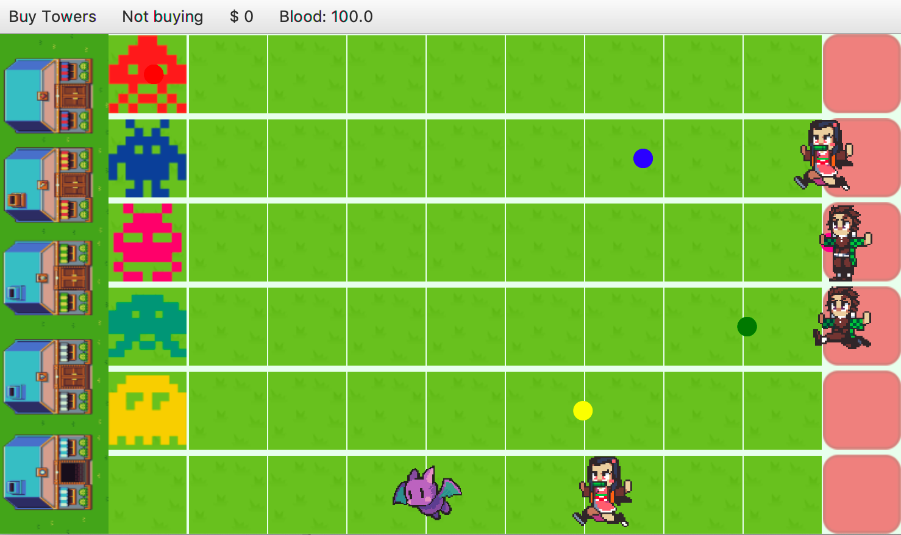

6 different towers, right click the tower to sell the tower.
If the enemies meet one tower, this tower will be destroyed.

Slide 6
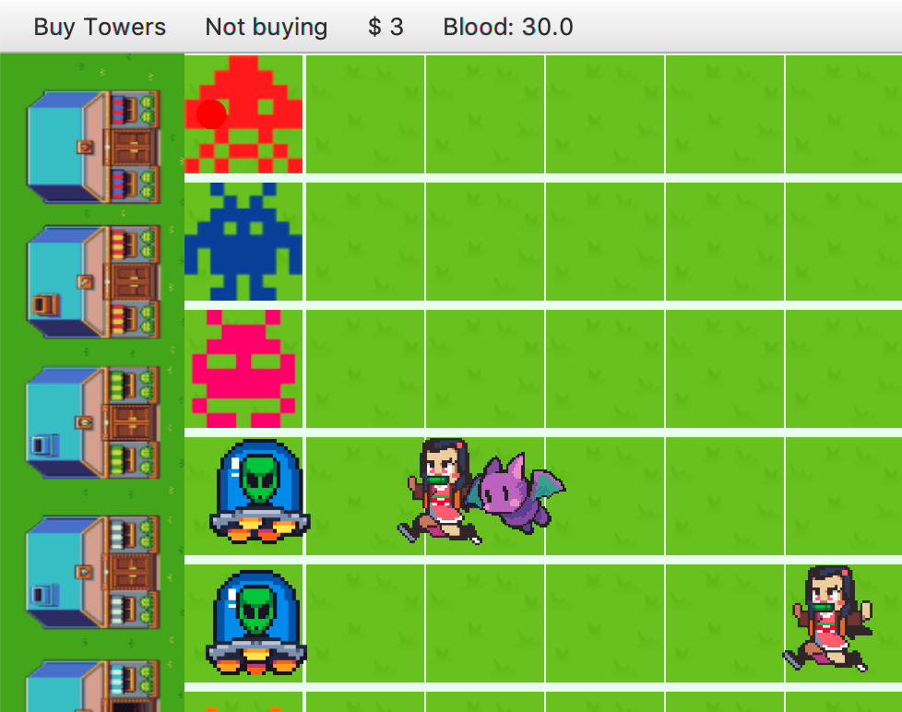
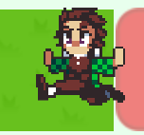
4 different types of enemy with different speed.
The amount of damage when they arrived home is also different. Faster enemy will hurt more.
When there are only 2 enemies left, there will be more enemies appear. And the amount of enemies will become more for each time they appear.

Slide 7
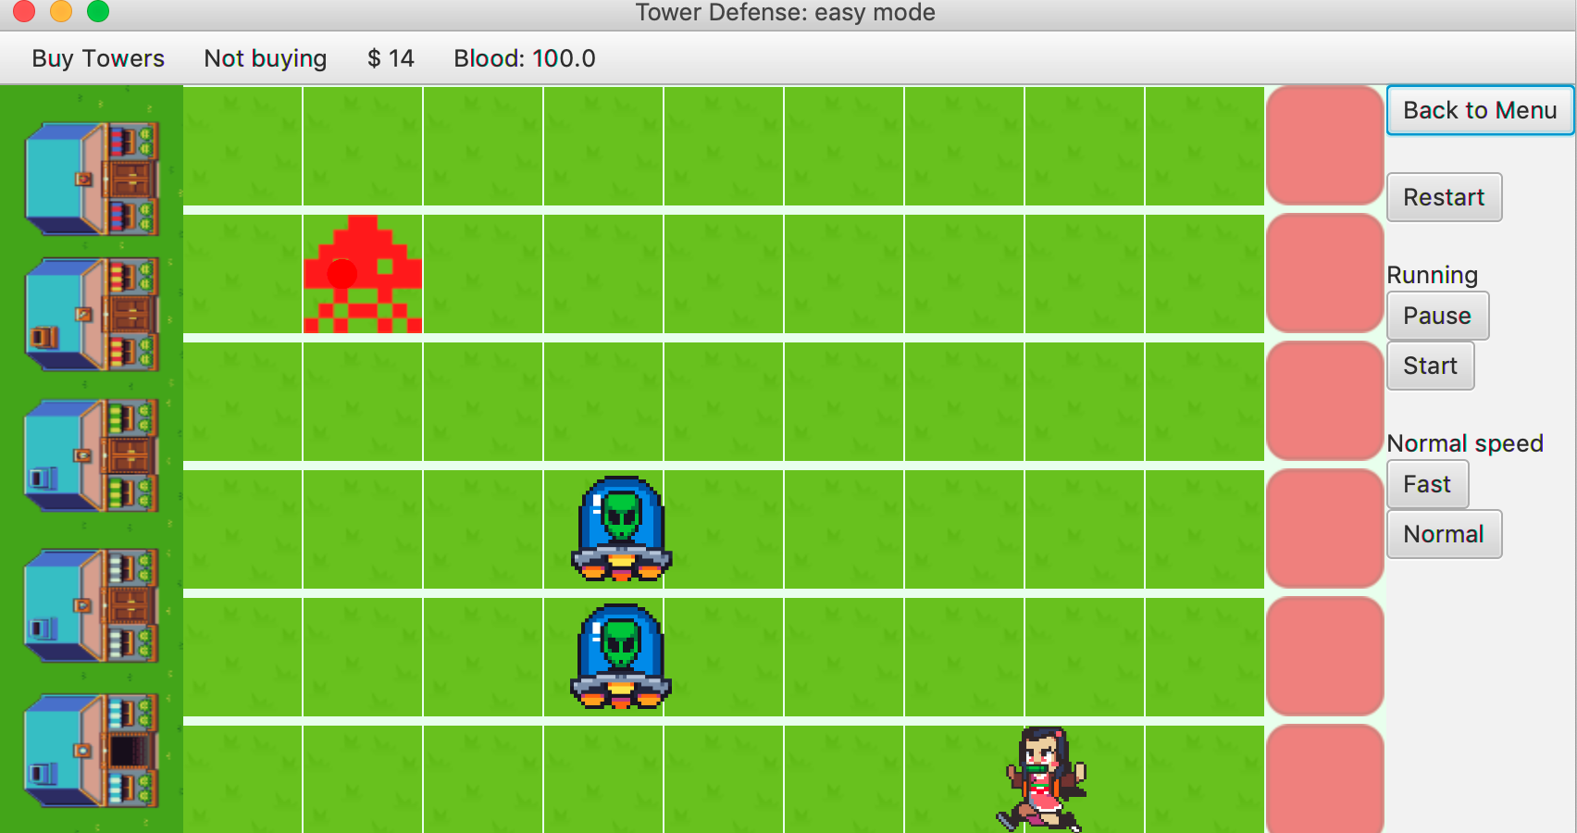
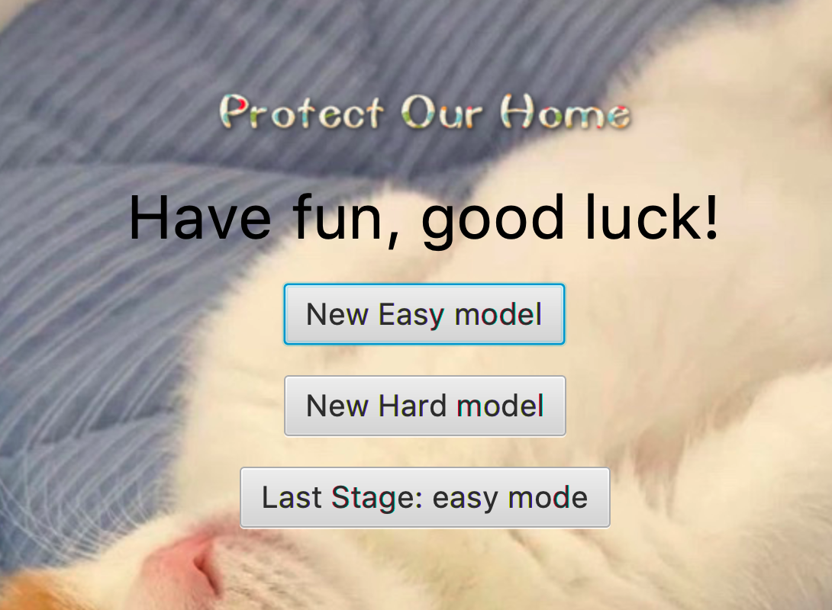

Slide 8
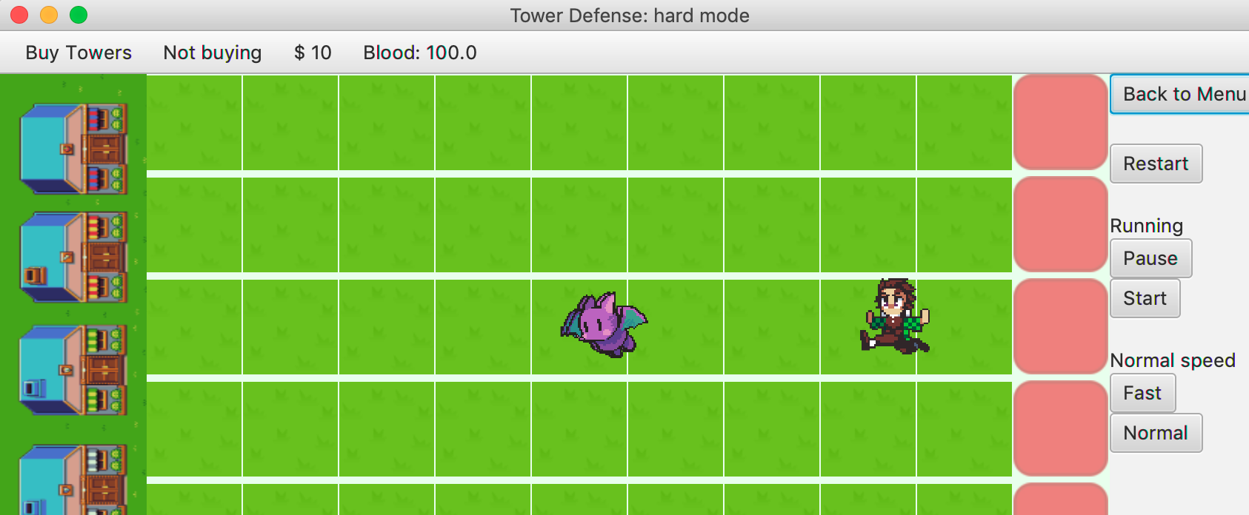
Enemies speed faster and only have $10.

Slide 9
